Slide 1

Transfer Learning for Mobile Phone-based Credit Scoring Srihari Sridharan, Isaac Markus
Skyler Speakman

Slide 2
Inclusive Financial Services
Payments
Savings
Credit
Insurance
Investments
Complexity

Slide 3





Inclusive Financial Services
Payments
Savings
Credit
Insurance
Investments

Slide 4
Inclusive Financial Services
Payments
Savings
Credit
Insurance
Investments
How can mobile phone data help?

Slide 5
Inclusive Financial Services
Access to financial services such as credit, savings, insurance is a global challenge
2-3 BILLION individuals and 200 MILLION businesses in emerging economies today lack access to savings and credit, and even those with access can pay dearly for a limited range of products.
[McKinsey Global Institute, Digital finance for all: Powering inclusive growth in emerging economies, 2016]

Slide 6
Inclusive Financial Services
Access to financial services such as credit, savings, insurance is a global challenge
Goal 8.10 of the “SDGs”
Strengthen the capacity of domestic financial institutions to encourage and expand access to banking, insurance and financial services for all.
[The 2030 Agenda for Sustainable Development, United Nations, 2015]

Slide 7
Overview
Savings & Loan Product
Registration Date
1 month monitoring
Time

Slide 8
Overview
Savings & Loan Product
Registration Date
Repaid all loans
77%
1 month monitoring
Defaulted at least one loan
Time
23%

Slide 9
Overview
Savings & Loan Product
Registration Date
Repaid all loans
77%
6 months of cell phone data
1 month monitoring
Defaulted at least one loan
Time
23%
Airtime Usage
Top-up Amount
Days out-of-airtime
Mobile money summaries
Airtime Credit

Slide 10
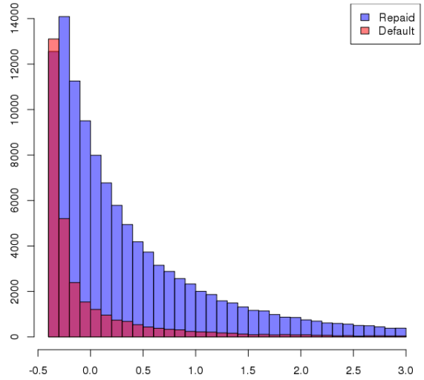

Data
Mobile Money Withdrawal
No. of Customers
Mobile Money Withdrawal Amount in 6 Months (std)

Slide 11
Decision Trees
Split data by choosing a feature and cutoff that separate the two classes
Many advantages:
Classification or regression
Real-valued or discrete predictors
Easily handles missing data
Scales to large data sets
Ignores irrelevant features

Slide 12
Boosting Decision Trees
Train a decision tree
(weak learner)

Slide 13
Boosting Decision Trees
Reweight data to prioritize the misclassifications

Slide 14
Boosting Decision Trees
Reweight data to prioritize the misclassifications
Train an additional tree on reweighted data

Slide 15
Boosting Decision Trees
Reweight data to prioritize the misclassifications

Slide 16
Boosting Decision Trees
Reweight data to prioritize the misclassifications
Train an additional tree on reweighted data

Slide 17
Boosting Decision Trees
A boosted sequence of weak learners becomes a strong learner
Boosting maintains advantages of decision trees
while increasing classification accuracy

Slide 18
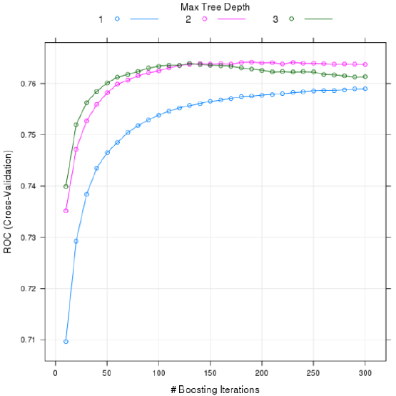
Boosting Parameters
How many trees?
How deep for each tree?
Cross validation is used to explore the space.
180 Trees of Depth 2 maximized AUC.

Slide 19
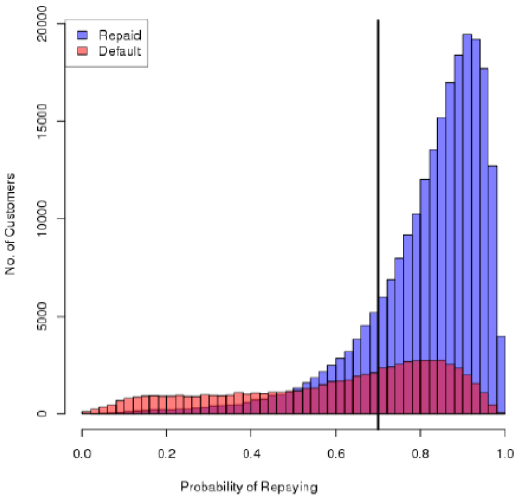
Results – Decreasing Defaults

Slide 20
Results – Decreasing Defaults
(specificity)
Retained 83% of paying customers
(sensitivity or recall)
Identified 55% of would-be defaulters

Slide 21
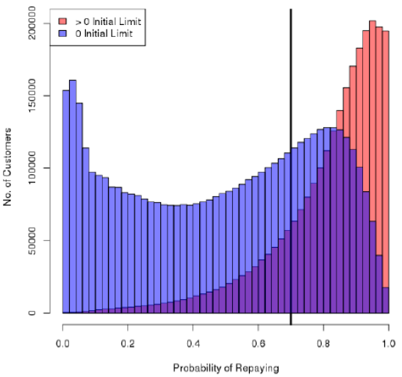
Results – Increasing Revenue
Notes:
35% of the 7M customers are given a positive initial limit. The bank’s LR approach actually does a decent job assigning positive limits to high probability customers.

Slide 22
Results – Increasing Revenue
+1 Million customers allowed on credit product
Notes:
35% of the 7M customers are given a positive initial limit. The bank’s LR approach actually does a decent job assigning positive limits to high probability customers.

Slide 23
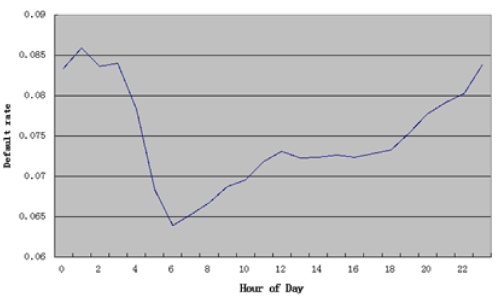
Insights

Slide 24
Launching in a New Market
Expanding the credit product is important for both business and financial inclusion purposes.
No labeled repayment data in the new market.
Unclear which members of new market will use the product.

Slide 25




Launching in a New Market
Original Market Borrower
New Market Borrower

Slide 26
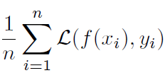
Launching in a New Market
Original Market Borrower
New Market Borrower

Slide 27
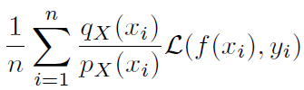
Launching in a New Market
“Covariate Shift”
(Two population)
Borrowers that ‘look like’ New Market Borrowers have weight increased
Original Market Borrower
New Market Borrower

Slide 28
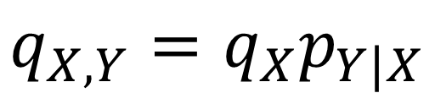
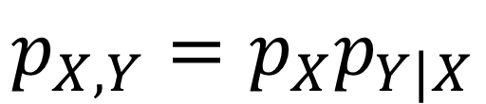
Launching in a New Market
“Covariate Shift”
(Two population)
Assumption #1:
Borrowers default for the same reasons in both markets
Original Market Borrower
New Market Borrower
=
$$p_{X,Y}=p_{X}p_{Y|X}$$
$$q_{X,Y}=q_{X}p_{Y|X}$$

Slide 29
Launching in a New Market
We do not know what a New Market Borrower looks like (yet)
Original Market Borrower
New Market Borrower
$$p_{X,Y}=p_{X}p_{Y|X}$$
$$q_{X,Y}=q_{X}p_{Y|X}$$

Slide 30

Launching in a New Market
Original Market
New Market
Leverage ‘background’ telco data in both markets
Original Market Borrower
New Market Borrower

Slide 31
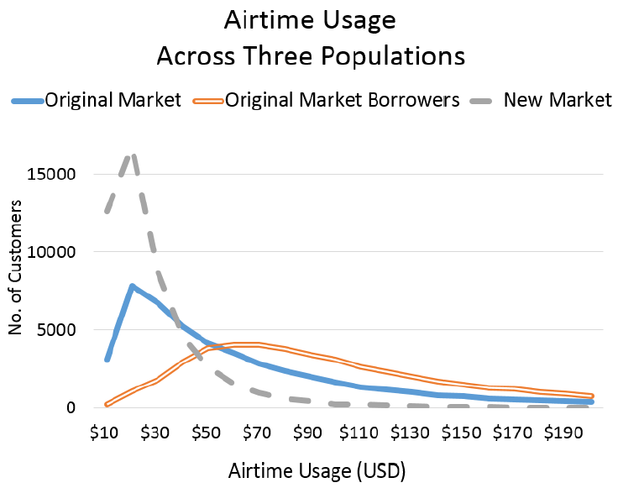

Slide 32
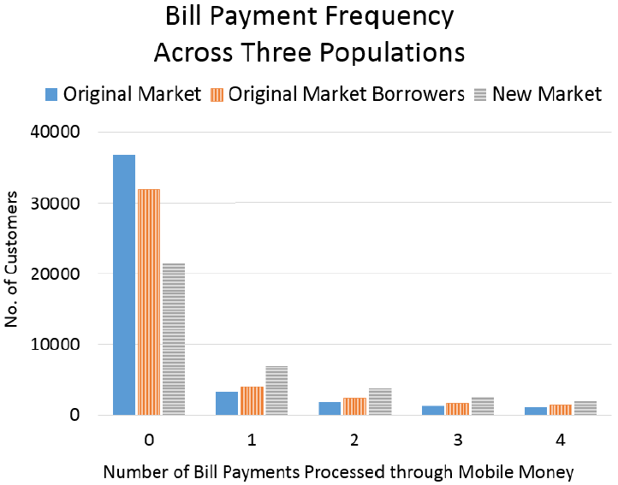

Slide 33
Launching in a New Market
Original Market
New Market
Three Population Covariate Shift
(Wei, Ramamurthy, Varshney SDM 2015)
Original Market Borrower
New Market Borrower

Slide 34
Launching in a New Market
Original Market
New Market
Assumption #2:
Original Market Borrower
New Market Borrower

Slide 35
Launching in a New Market
Original Market
New Market
Assumption #2:
Borrowers request a loan for the same reasons in both markets
Original Market Borrower
New Market Borrower

Slide 36
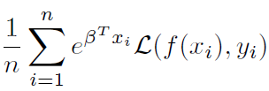
Launching in a New Market
Original Market
New Market
Logistic Regression between Original and
New Markets is used to re-weight
Original Market Borrowers
Original Market Borrower
New Market Borrower

Slide 37
Launching in a New Market
Assumption #3:
Logistic Regression can estimate the ratio of two market distributions
New Market
Original Market
Original Market Borrower
New Market Borrower

Slide 38
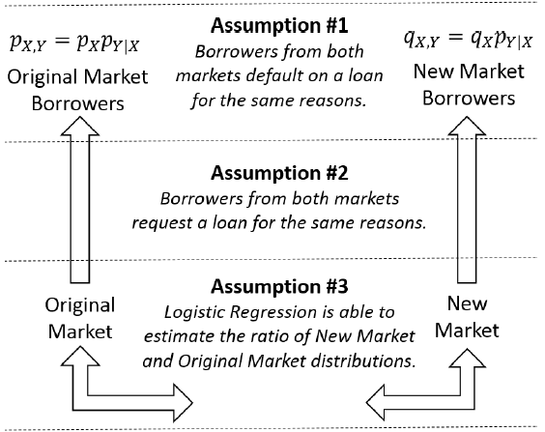
Launching in a New Market
Assumptions for
Three Population Covariate Shift

Slide 39




Slide 40
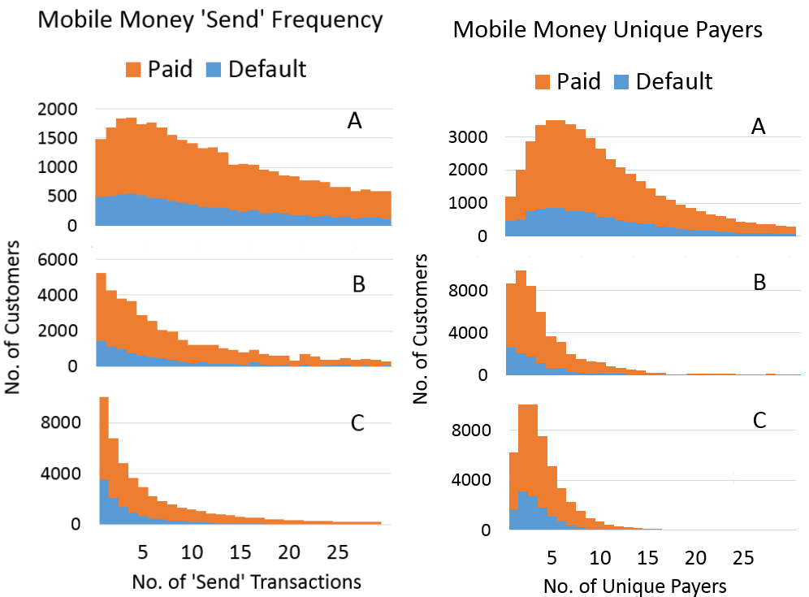
Results

Slide 41
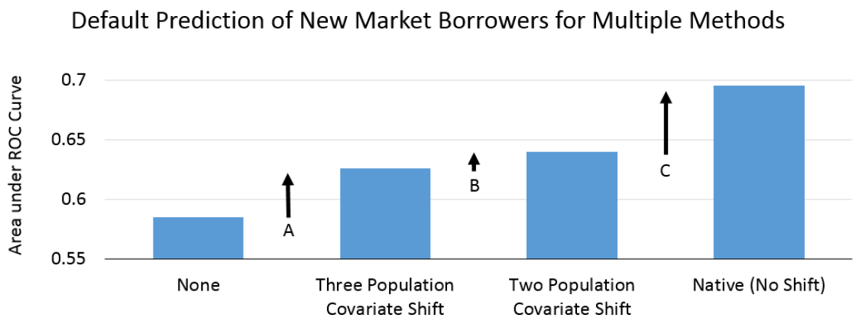
Results

Slide 42
Summary
Mobile Phones and data they generate have tremendous potential for increasing access to financial services in both developed and developing markets.
Sub-Saharan Banks and MNO’s are building products on top of mobile money platforms.
Launching a mobile money credit product in a new market is risky but a priority for both competitive advantage and increased financial inclusion.
Transfer learning methods help alleviate the challenge of sparse labeled data.
Three-population Covariate Shift is an early (first?) example of work in this space.
Further improvements are likely.

Slide 43
skyler@ke.ibm.com
@PhonesDrones

